Slide 1
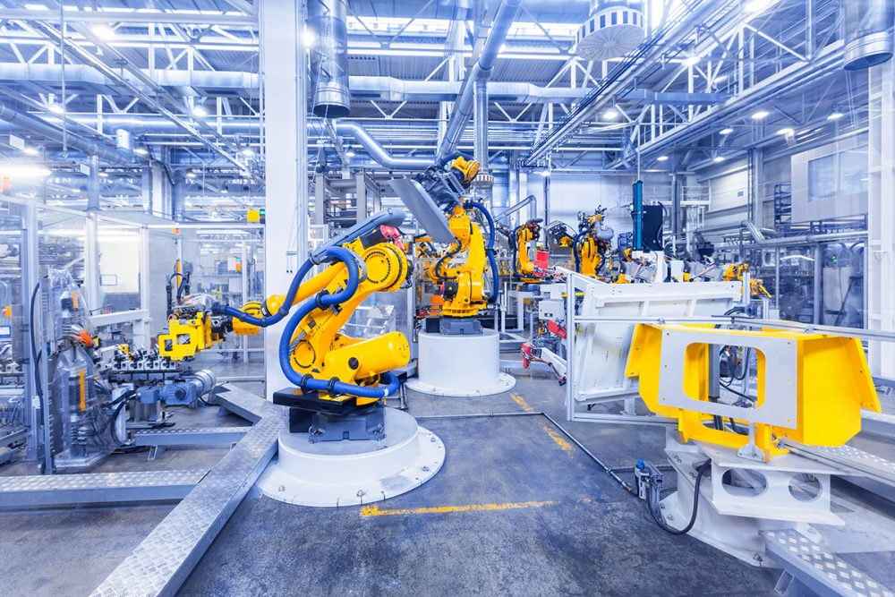
Soumyadip Bandyopadhyay
Formal Verification of PLC Software Evolution Across Migration and Upgrade
Notes:
Today I’ll present our work Antarbhukti (“Containment”) — a formal approach to verify PLC software correctness during evolutionary upgrades.
It tackles a key challenge in industrial automation: ensuring upgrades don’t break previously correct behavior.
I’ll cover the motivation, our Petri net–based containment framework, symbolic equivalence algorithm, results on 80 real-world PLC programs, Industrial use case and open research directions.

Slide 2
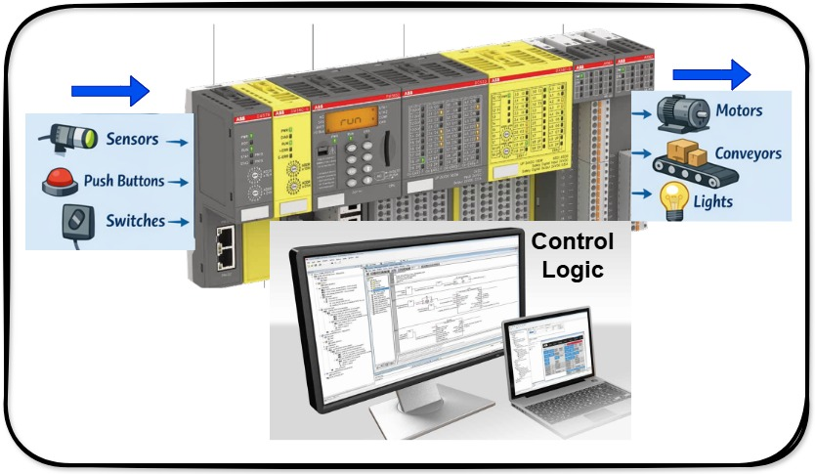
What is PLC?
PLC stands for Programmable Logic Controller
PLC works like the brain of a machine
It takes inputs from the field
PLC processes the input using a program
It gives output based on the logic
PLC works continuously and very fast
Easy to change operation
Notes:
PLC stands for Programmable Logic Controller
It is a small industrial computer used to control machines automatically.
PLC works like the brain of a machine
Just like our brain takes decisions, a PLC decides what a machine should do.
It takes inputs from the field
Inputs are signals coming from:
Sensors
Push buttons
Switches
Temperature or pressure devices
PLC processes the input using a program
Inside the PLC, a program (logic) is stored that says:
“If this happens → then do that.”
It gives output based on the logic
Outputs can be:
Motors ON/OFF
Lights ON/OFF
Conveyor belt movement
Valves opening or closing
PLC works continuously and very fast
It checks inputs and updates outputs many times per second.
Used mainly in factories and industries
Common places:
Manufacturing plants
Power plants
Water treatment plants
Oil & gas industries
Easy to change operation
If the process changes, we just change the program, not the wiring.

Slide 3
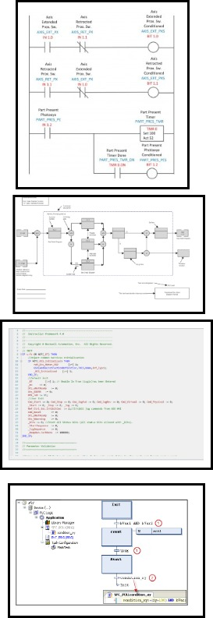
PLC Compliance Programing Languages (IEC 61131-3)
Ladder Diagram (LD)
Function Block Diagram (FBD)
Structure Text (ST)
Sequence Function Chart (SFC)
Notes:
IEC 61131-3 is the international standard for PLC programming that ensures portability, reliability, and safety across automation platforms. It defines four languages—Ladder Diagram (LD), Function Block Diagram (FBD), Structured Text (ST), and Sequential Function Chart (SFC) to address different control needs. Graphical languages (LD, FBD, SFC) support intuitive design and maintenance, while Structured Text enables compact implementation of complex logic.

Slide 4
PLC Upgrade Challenges
Industrial PLC systems evolve frequently
Manual regression testing is slow
Need formal assurance without full re-testing
Notes:
Industrial PLC systems — running assembly lines or robotic arms — keep evolving with new sensors, safety checks, and updates.
But every upgrade risks breaking earlier correct behavior, leading to costly downtime or safety issues.
Traditional regression testing is manual and incomplete . That means there is a scope for Bug. So, we ask a formal question:
Does the new PLC version preserve all behaviors of the old one?
If yes, the upgrade can be certified with confidence.

Slide 5
Existing Approaches
Safety-critical PLC verification has grown significantly since 2000, with extensive literature on IEC 61131-3 languages.
Two dominant SFC verification paradigms:
  Model checking – translates SFCs to transition systems (timed/hybrid automata, state machines) for safety/liveness properties.
  Theorem proving – formally certifies SFC specifications.
Existing tools like verifAPS check version equivalence using inductive inference.
Behavioral verification is well-studied at code and model level, but focuses on generic property checking, not evolution.
Gap: No prior work on path-based behavioral containment specifically for PLC software upgrades — this is the unique focus of Antarbhukti.
Notes:
You might ask — aren’t there already tools for PLC verification?
Yes, there are.
Most existing methods focus on property verification using model checking or theorem proving.
Tools like verifAPS and generalized Petri net analyzers do exist,
but they assume static net structures and struggle with PLC tick semantics — the cycle-based synchronous execution model.

Slide 6
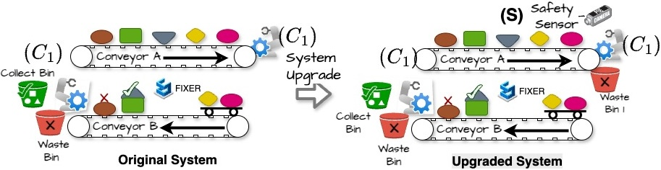
Motivating Example (A pick-and-place unit(PPU))
ORIGINAL
  Automated robotic arm transfers items from Conveyor A to Conveyor B.
  Conveyor B uses a scaling sensor to verify parameters whether to deposit it in the Green Bin or Discard it in the Red bin
UPGRADED
  A safety guard sensor per ISO 10218-1 standards.
  When the safety guard is in place, the robot proceeds with item transfer and scaling checks.
  Computes scaling factor adjustments parallelly for increased efficiency.
Notes:
To make this more concrete — consider an automotive plant where a PLC controls a robotic assembly step. An upgrade introduces a new emergency-check branch. Everything compiles, simulations pass, but in a rare interleaving, a valid sequence from the old logic becomes unreachable. Engineers won't notice unless they test that exact path — and they often missed out. This is exactly the kind of silent regression we are targeting.
So rather than just test the new version, we compare it behaviorally with the previous version — formally, at the model level. (two different slide)

Slide 7
Motivating Example (PPU)
The original PLC logic is straightforward: move arm → detect object → grip → place.
In the upgraded version, a quality-check condition is inserted before the grip.
The classical testing tool like LTB is not useful for two reasons.
  An SFC software testing generally takes 3 to 5 minutes by an expert engineer in a testing environment.
  The older version is purely sequential, whereas the upgraded version has parallelism, as it performs the scaling computation parallelly.

Slide 8
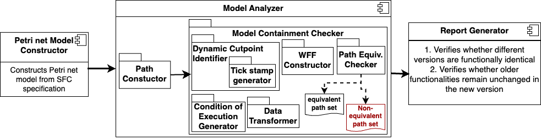
Symbolic Containment: Key Idea
ATVA 2025 — Formal Verification
Three main components:
Petri Net Model Constructor
Model Analyzer
Report Generator
Notes:
Our approach begins by translating both the original and upgraded PLC programs into Petri nets.
Specifically, we operate on the SFC — Sequential Function Chart — representation, which is a common high-level model used in industrial PLC programming.
The intuition here is that Petri nets give us a clean mathematical semantics of concurrency, synchronization, and token flow — all of which are essential to reason about PLC execution correctly.
This is one of the key differences from prior works like verifAPS — and a major reason why we achieve faster and more accurate containment checking.
Petri Net Model Constructor
Translates SFC programs directly into Petri nets
Preferred for the semantic alignment with SFCs
Traditional Petri net equivalence fails under PLC tick semantics
Model Analyzer
Execution cut-points introduced
Enables accurate modeling of synchronous transitions
Compute path cover with execution cut-points
Check symbolic path equivalence for containment
Report Generator
Produces detailed textual results explaining containment success or pinpointing the cause of violations

Slide 9
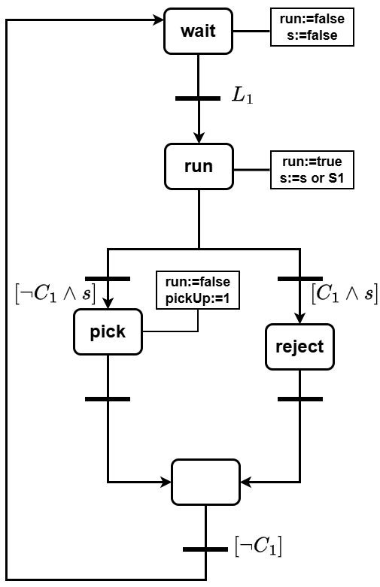
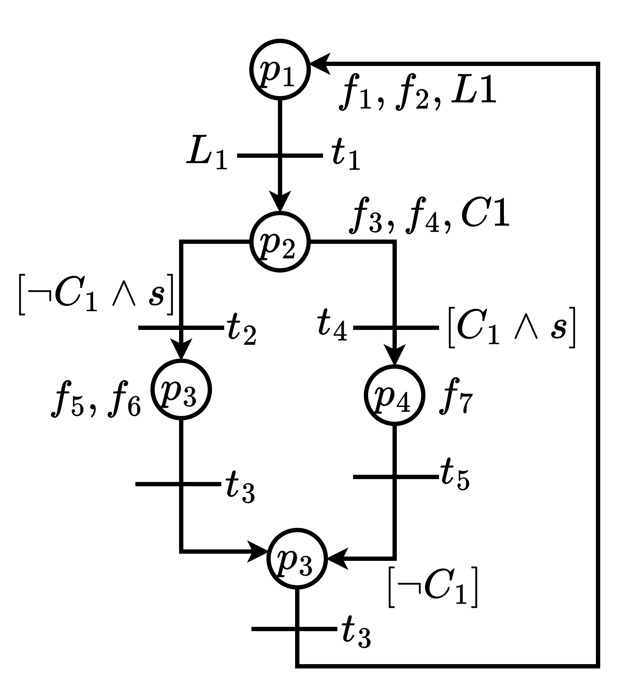
SFC to Petri net Translation
p5
t6
f1 | f2 | f3 | f4 | f5 | f6 | f7
run=false | s=false | run=true | s=s or S1 | run=false | pickup=1 | reject

Slide 10
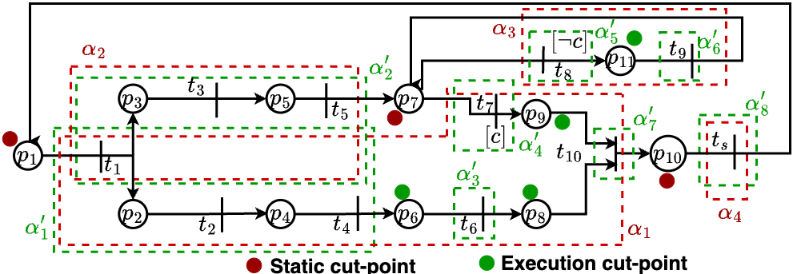
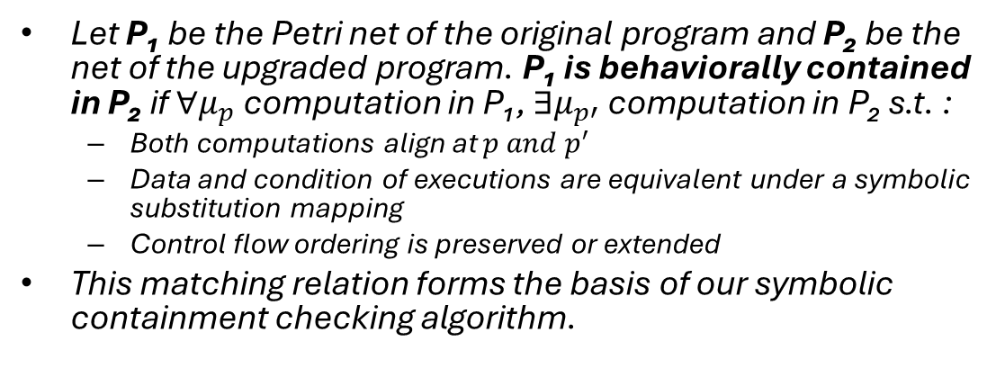
Concept of Execution Cut Point
Soundness: Any computation can be represented as concatenation of parallel paths syntactically.
To prove this, we need the concept of execution cut-point.
Effect: Reduces state explosion, preserves PLC tick semantics, and improves symbolic equivalence precision
What is Containment
Let P₁ be the Petri net of the original program and P₂ be the net of the upgraded program. P₁ is behaviorally contained in P₂ if $∀μ_{p}$ computation in P₁, $∃μ_{p′}$ computation in P₂ s.t. :
  Both computations align at $p and p^{′}$
  Data and condition of executions are equivalent under a symbolic substitution mapping
  Control flow ordering is preserved or extended
This matching relation forms the basis of our symbolic containment checking algorithm.
Notes:
So what does containment mean in this context? For every computation in the original PLC program, a corresponding — or equivalent — computation must exist in the upgraded version. If that is guaranteed, then the upgrade is correct with respect to previous behavior.
Notice that we are not doing full equivalence checking here — we are doing containment, a one-sided check. This is important because upgrades often add behavior, which is fine — as long as they don’t remove old computation tarce. Due to presence of loop how many times loop will be executed we do not know. So using classical program verification technique we cut the loop in at least one cut-point and break the computation in a set of paths such that any computation can be represented as concatenation of parallel paths. To do this we need to bring the concept of execution cutpoint. Check the figure…

Slide 11
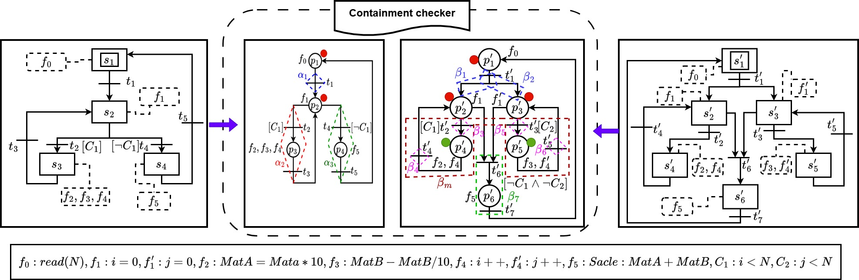

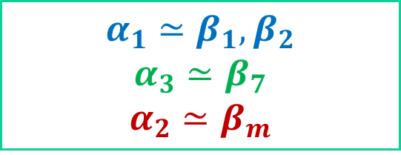
Containment Checking: Example1
ATVA 2025 — Formal Verification
$$α_{1}≃β_{1},β_{2}$$
$$α_{3}≃β_{7}$$
$$α_{2}≃β_{m}$$
$$β_{m}:\left(β_{3}⋅β_{4}\right)\text{⋈}(β_{5}⋅β_{6})$$
ATVA 2025 | Antarbhukti: PLC Software Containment Checking
Notes:
this slide shows a high-level description of our containment checking algorithm through an example. Notice that we do not iterate over individual transitions. Instead, we iterate over paths, which significantly reduces computational overhead.
The matching step invokes a lightweight symbolic equivalence checker. Unlike full bisimulation, our matching is directional — we only require that every path in N0 has a corresponding path in N1. This is why we refer to the approach as Antarbhukti — one net being included within another.

Slide 12
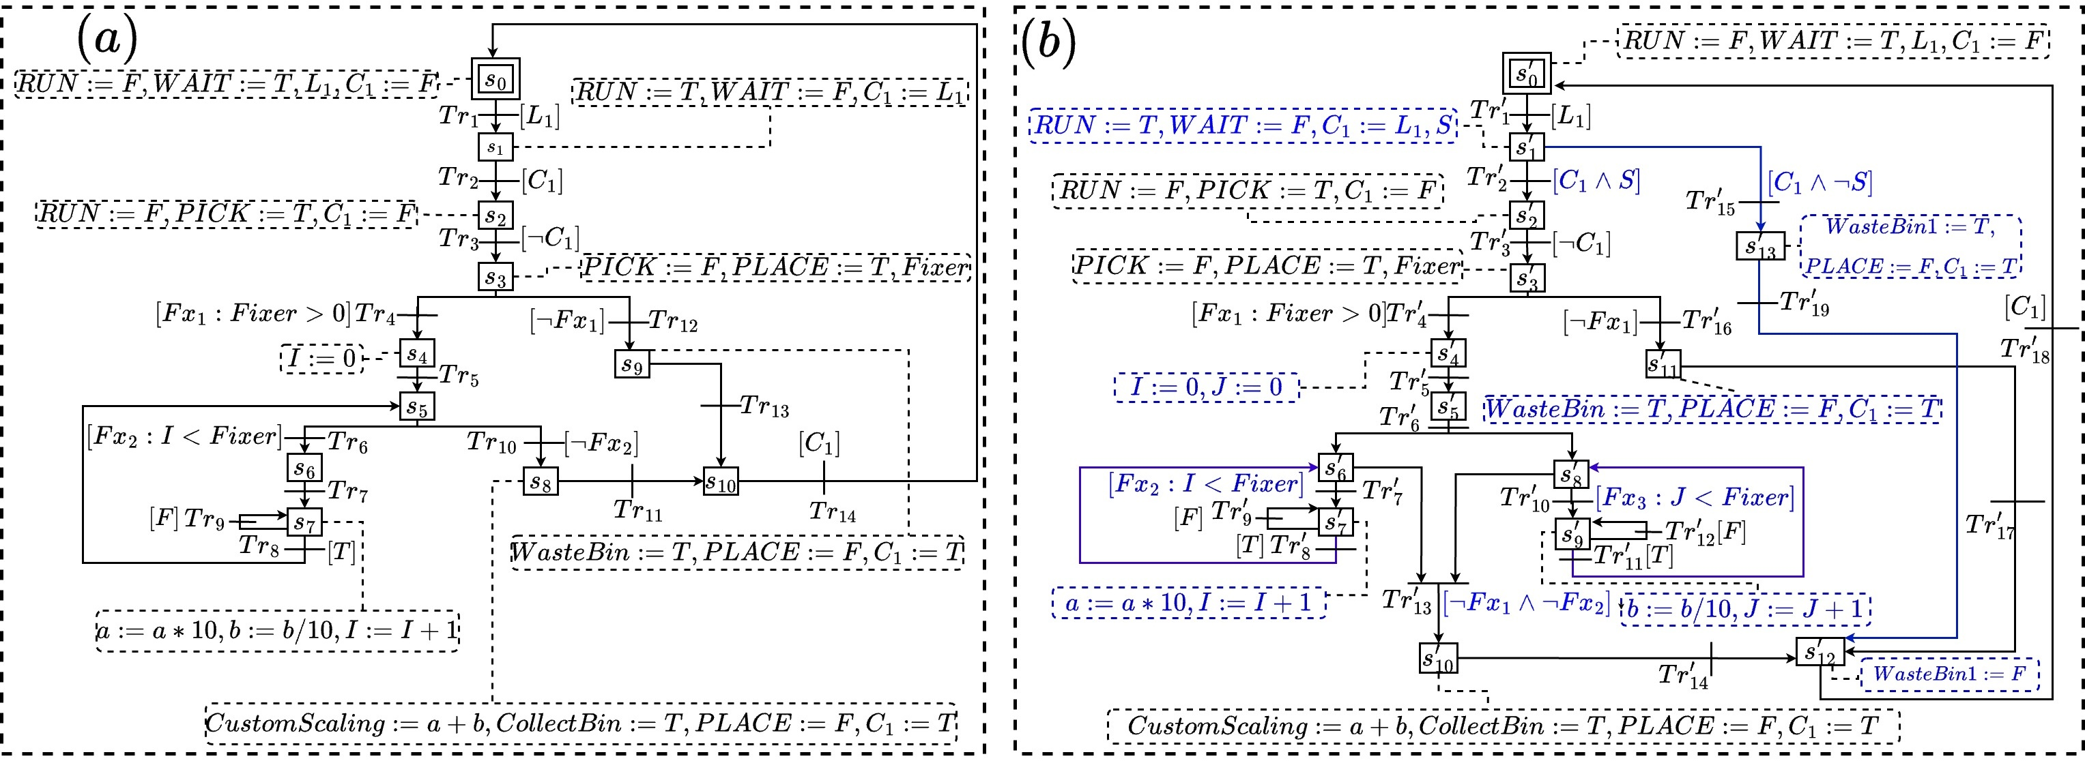
Containment Checking: Example 2 (PPU)
Notes:
Revisit our motivating example. Fig (a) represents the SFC representation of original systems and Fig (b) represents the SFC representation of upgraded systesm.

Slide 13
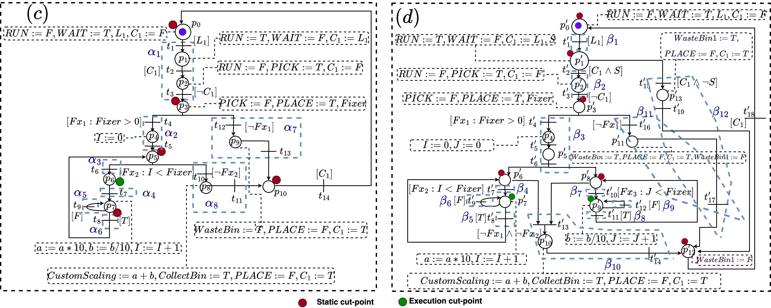
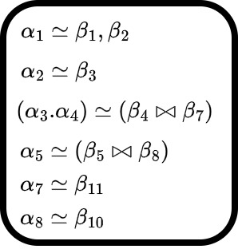
Containment Checking: Example 2
Results
Notes:
Fig© and Fig (D) are the corresponding Petri net representation. And it shows the list of equivalent paths.

Slide 14
Experimental Results
Evaluated on 80 PLC applications from OSCAT library (out of 1,000 total)
Categorized as: Basic, Simple, Medium, Complex (based on LOC and structure depth)
Benchmarks included both correct and faulty upgrades
Observations:
  Path merging in Medium & Complex cases
  Path extension in Simple & Complex cases
  4× faster than verifAPS due to direct Petri net translation
Notes:
We evaluated our approach using the publicly available OSCAT Automation Library, which includes over 80 real PLC programs from domains like safety checks, counters, and motion control.
For each program, we created both correct and faulty upgrade scenarios to test our checker on true positives and true negatives.
This slide compares our tool, Antarbhukti, with verifAPS, a state-of-the-art PLC verifier.
In most cases, Antarbhukti performs containment checking up to 4× faster, especially in programs with higher concurrency.
While verifAPS often times out, Antarbhukti finishes within 3–4 seconds, demonstrating practical scalability.

Slide 15
Limitations and Future Work
Cannot handle hierarchical SFC
  Extending containment semantics to nested SFC structures using compositional Petri net encoding.
Fails on functionally equivalent but non-bisimilar code
  Using inductive inferencing technique
No support for TON timing blocks
  Incorporating timed tokens and clock constraints, allowing us to reason about TON/TOF behaviors faithfully.
Notes:
There are three major ongoing extensions we are currently exploring:
1. Hierarchical Containment: Extending containment semantics to nested SFC structures using compositional Petri net encoding.
2. Timed Containment: Incorporating timed tokens and clock constraints, allowing us to reason about TON/TOFbehaviors faithfully.
3. Semantic Equivalence Loosening: Detecting when two different upgrade paths are functionally identical under delay or reordering, even if they fail direct bisimulation.
We believe these are natural next steps.

Slide 16
Conclusion
We proposed Antarbhukti, a novel containment checking framework for PLC evolution.​
Introduced execution cut-points to model PLC tick semantics effectively.​
Used symbolic path summaries instead of full trace enumeration — enabling scalability.​
Achieved 4× performance improvement over verifAPS on 80 real-world programs.​
Designed with industrial adoption in mind — no manual annotations required.
Notes:
Along with PLC upgrade verification, To our knowledge, this is the first scalable containment checker purpose-built for PLC upgrade verification. We believe Antarbhukti opens a new direction in evolution-aware formal verification, where upgrades are analyzed not as isolated programs, but as behaviorally related families of models. Its extensions can support several real industrial scenarios. We also thank the maintainers of the OSCAT PLC library for providing benchmarks.

Slide 17
Use Case: Software Migration
Control code migration is needed to have efficient and up-to-date control systems with state-of-the-art performance and enhanced security and regulatory compliance.
Code migration must ensure that the new applications perform identically to the previous ones, minimizing operational risks.
Software migration
Heritage Code
Modern Code
Equivalence
?
Benefits
Retain Customer->Certification
Testing effort reduce
(30min to 1 hr)->(1 to 4 mints)
Notes:
Now we move to the heart of software evolution:
migrating legacy TCL control logic into modern IEC61131-3 models.
“TCL-to-SFC migration is becoming increasingly important in modern industrial automation.
Many factories still run on old text-based TCL logic, which is hard to maintain, hard to visualize, and error-prone during upgrades. SFC,
on the other hand, is a structured, graphical model that makes system behavior easier to understand, verify, and modify.
Migrating from TCL to SFC gives industries better clarity, safer updates, and improved long-term maintainability.
It helps engineers see the control flow clearly, reduces mis interpretation, and supports advanced analysis tools.
In short, this migration is not just a format change — it’s a step toward more reliable, transparent, and future-ready automation systems.”

Slide 18
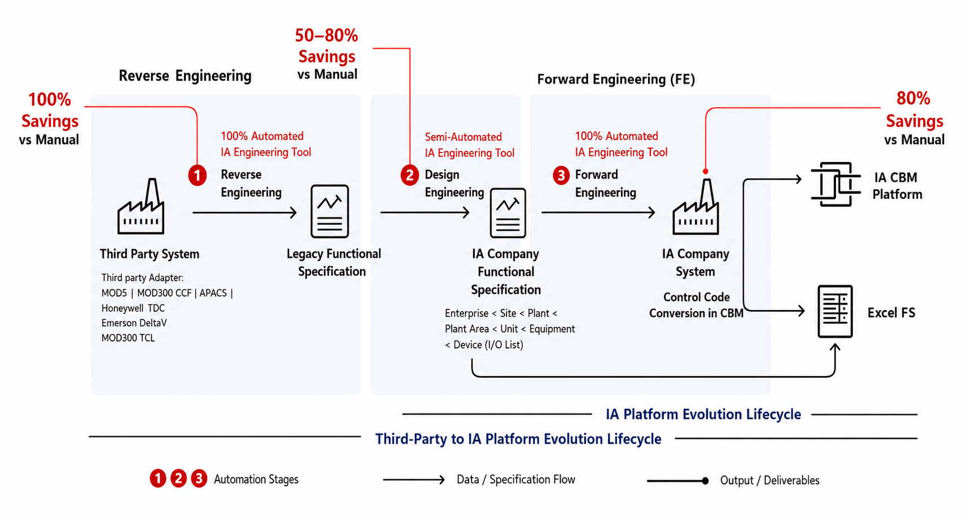
Migration journey
Notes:
This slide illustrates the complete migration journey — how a third-party control system can be transitioned into the ABB 800xA ecosystem with significant cost and effort savings.
It starts with legacy systems such as MOD5, MOD300, APACS, or DeltaV. Manual conversion is typically slow and error-prone, but automated tools like caFE can extract functional specifications automatically, achieving 100% savings compared to manual work.
In Step 2: Design Engineering, semi-automated translation converts legacy specifications into ABB-style functional specifications, resulting in 50–80% effort savings.
In Step 3: Forward Engineering, a fully automated caFE pipeline generates ABB-ready logic directly deployable in the 800xA CBM environment, again with around 80% savings.
Integrating a verifier during design further reduces testing costs, enhances customer confidence, and promotes software sustainability by ensuring reliable system evolution.

Slide 19
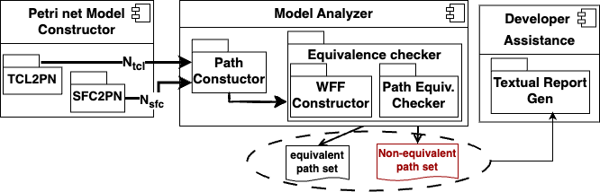
System Architecture
Notes:
The pipeline ensures the migrated SFC preserves the original TCL behavior.
It converts both to Petri-net models, checks their logical equivalence, and reports mismatches — ensuring consistent, reliable migration.

Slide 20
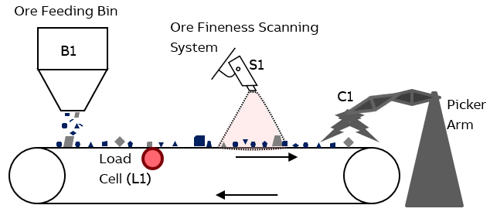


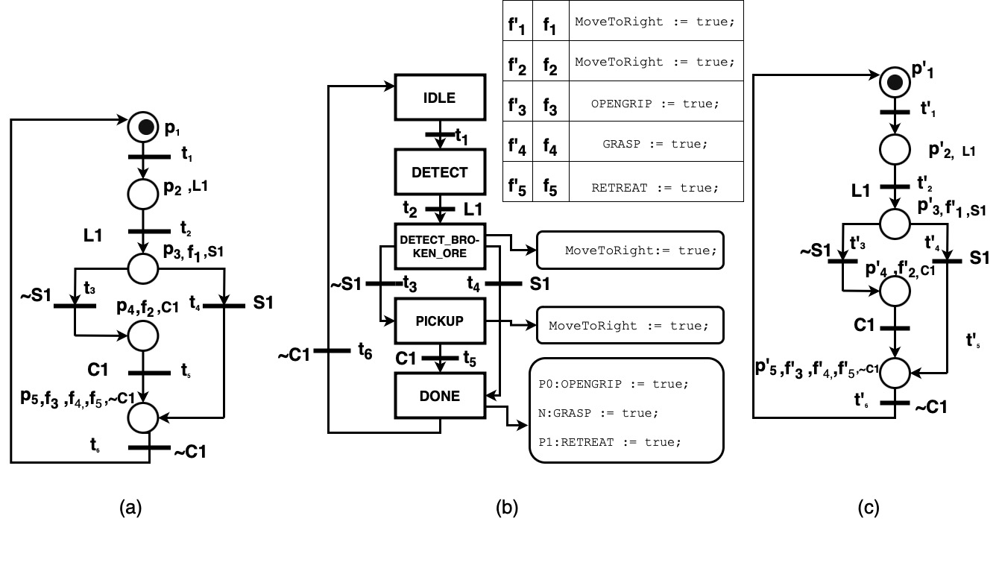
A Toy Example
BEGIN
VAR
MoveToRight : BOOL;
DBVAR
OBJECTCOND, OPENGRIP, GRASP, RETREAT : BOOL;
L1, C1,S1 : INT;
STEP 'DETECT'
IF($'Conveyor123D'.L1 = 1)
MoveToRight := true;
ENDSTEP
STEP 'DETECT_BROKEN_ORE'
IF($'S1'.OBJECTCOND = #BROKEN)
GOTO 10;
ELSE
MoveToRight := true;
ENDSTEP
STEP 'PICKUP'
IF($'Conveyor123D'.C1 = 1)
$'Crane3070'.OPENGRIP := true;
$'Crane3070'.GRASP := true;
$'Crane3070'.RETREAT := true;
ENDSTEP
10: STEP 'DONE'
ENDSTEP
END.
Migration
Antarbhukti
MC:Model constructor
TCL Code
Model-2
SFC
Model-1
May No
Equivalence checker
Yes
Notes:
The legacy PLC and migrated SFC are converted into Petri-net models (Model-1 and Model-2).
After normalization, the equivalence checker compares their behaviors.
A “Yes” confirms correct migration; a “No” flags possible functional deviations — enabling scalable, automata-based verification for industrial PLC upgrades.

Slide 21
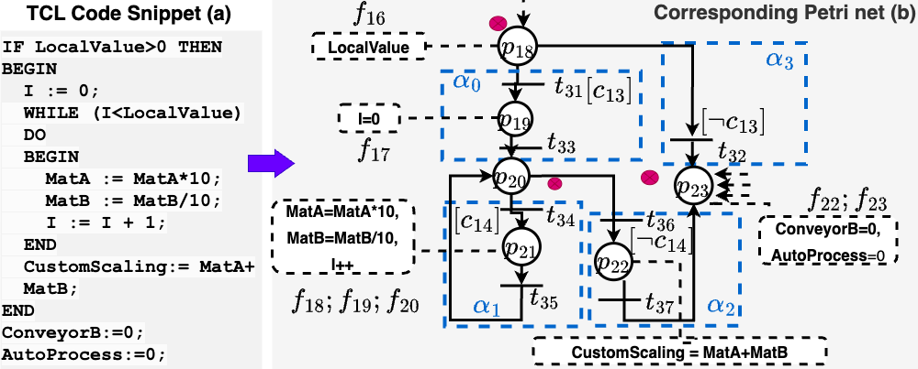
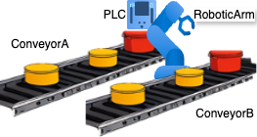
Real-life Example
Notes:
This slide shows a real industrial example.
On the left is a TCL code snippet that performs custom scaling of two materials.
On the right is the Petri net automatically generated from that code using PRESGEN TOOL.

Slide 22
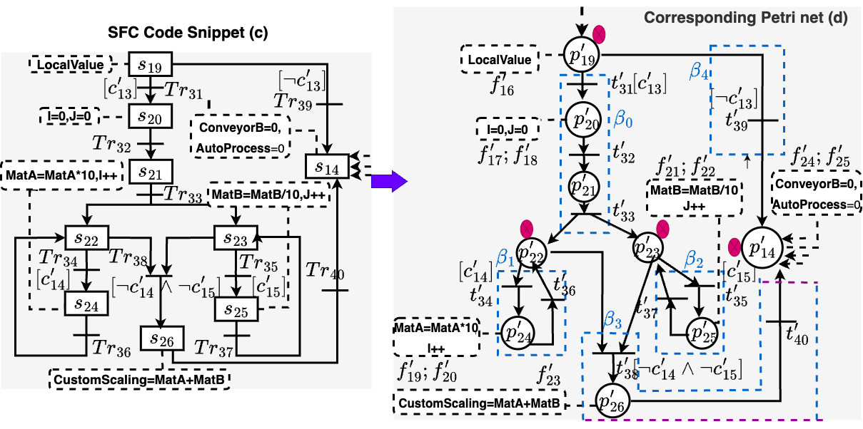
Real-life Example
Notes:
Figure (c) shows the SFC model obtained by migrating the TCL code from Figure (a).
Figure (d) is the corresponding Petri net generated from that SFC.
This translation is performed automatically by the Model Constructor component of Antarbhukti.

Slide 23
Real-life Example
Soundness: Any computation can be represented as a concatenation of paths semantically.
Notes:
Let me recap this part clearly.
Figure (b) is the Petri net generated from the original TCL code in Figure (a).
Figure (d) is the Petri net generated from the migrated SFC model shown in Figure (c).
Our equivalence checker now compares these two Petri nets — the old behavior and the migrated behavior.
Before checking equivalence, the soundness of the method is :
any computation can be represented as a concatenation of paths semantically.

Slide 24
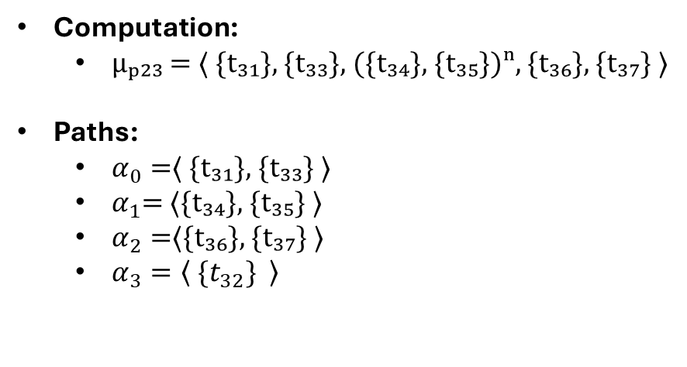
Soundness proof
Computation:
  μₚ₂₃ = ⟨ {t₃₁}, {t₃₃}, ({t₃₄}, {t₃₅})ⁿ, {t₃₆}, {t₃₇} ⟩
Paths:
  $α_{0}=$⟨ {t₃₁}, {t₃₃} ⟩
  $α_{1}$= ⟨{t₃₄}, {t₃₅} ⟩
  $α_{2}=$⟨{t₃₆}, {t₃₇} ⟩
  $α_{3}=\left\langle \{t_{32}\} \right\rangle$
Notes:
Lest take the computation is of the form μₚ₂₃ = ⟨ {t₃₁}, {t₃₃}, ({t₃₄}, {t₃₅})ⁿ, {t₃₆}, {t₃₇} ⟩
And the corresponding path sets are
$α_{0}=$⟨ {t₃₁}, {t₃₃} ⟩
$α_{1}$= ⟨{t₃₄}, {t₃₅} ⟩
$α_{2}=$⟨{t₃₆}, {t₃₇} ⟩
$α_{3}=\left\langle \{t_{32}\} \right\rangle$

Slide 25
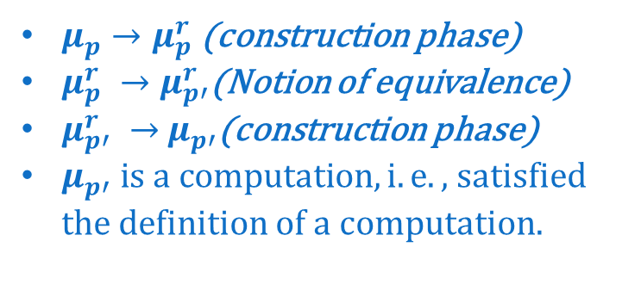
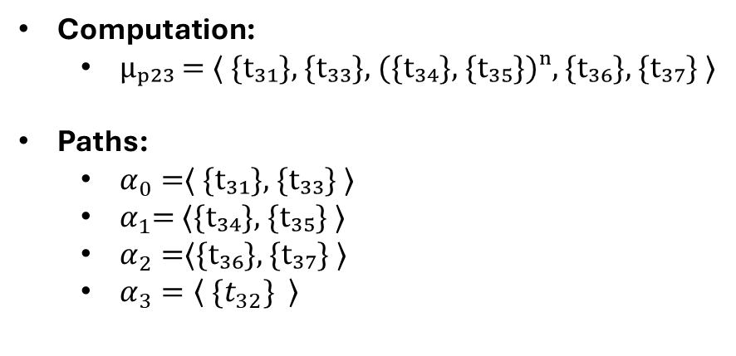
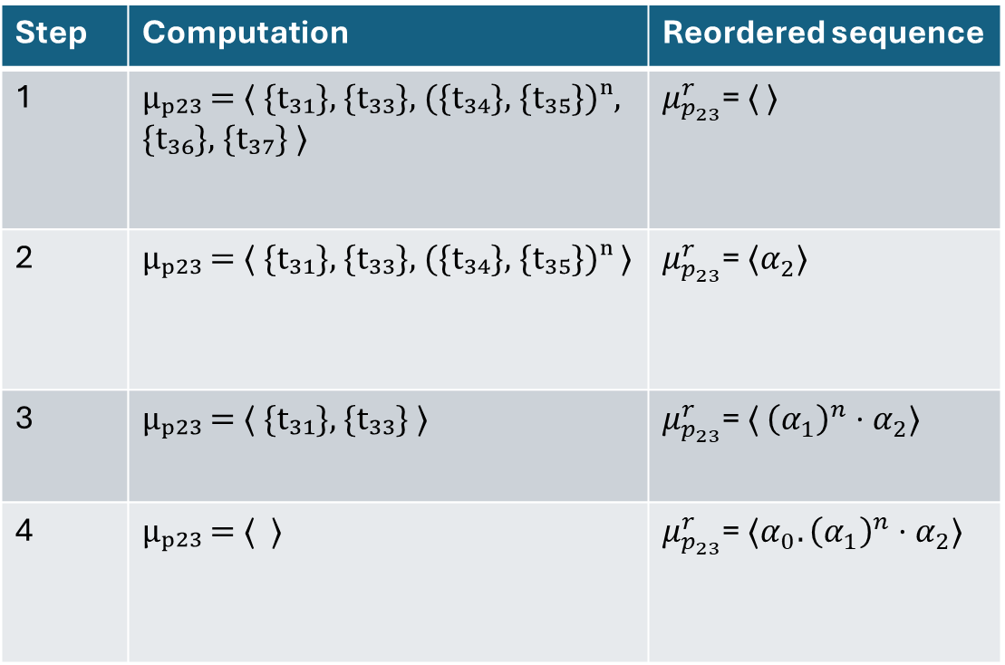
Soundness Proof
Step | Computation | Reordered sequence
1 | μₚ₂₃ = ⟨ {t₃₁}, {t₃₃}, ({t₃₄}, {t₃₅})ⁿ, {t₃₆}, {t₃₇} ⟩ | $μ_{p_{23}}^{r}$= ⟨ ⟩
2 | μₚ₂₃ = ⟨ {t₃₁}, {t₃₃}, ({t₃₄}, {t₃₅})ⁿ ⟩ | $μ_{p_{23}}^{r}$= ⟨$α_{2}$⟩
3 | μₚ₂₃ = ⟨ {t₃₁}, {t₃₃} ⟩ | $μ_{p_{23}}^{r}$= ⟨ ${\left(α_{1}\right)}^{n}⋅α_{2}$⟩
4 | μₚ₂₃ = ⟨ ⟩ | $μ_{p_{23}}^{r}$= ⟨$α_{0}.{\left(α_{1}\right)}^{n}⋅α_{2}$⟩
Computation:
  μₚ₂₃ = ⟨ {t₃₁}, {t₃₃}, ({t₃₄}, {t₃₅})ⁿ, {t₃₆}, {t₃₇} ⟩
Paths:
  $α_{0}=$⟨ {t₃₁}, {t₃₃} ⟩
  $α_{1}$= ⟨{t₃₄}, {t₃₅} ⟩
  $α_{2}=$⟨{t₃₆}, {t₃₇} ⟩
  $α_{3}=\left\langle \{t_{32}\} \right\rangle$
Proof sketch
$μ_{p}→μ_{p}^{r}$ (construction phase)
$μ_{p}^{r} →μ_{p′}^{r}$(Notion of equivalence)
$μ_{p′}^{r} →$ $μ_{p′}$(construction phase)
$μ_{p′} is a computation,i.e.,$ satisfied the definition of a computation.
Notes:
Step 1:
The reordered sequence is initialized as empty.
The last elements of μₚ₂₃ is {t₃₇}, where {t₃₇} marks the end of path α₂.
Hence, path α₂ is appended to the reordered sequence.
All transitions belonging to α₂ are then removed from μₚ₂₃.
Step 2:
The new last member of μₚ₂₃ corresponds to the end of path α₁.
Therefore, α₁ is appended n times before α₂ in the reordered sequence.
The process continues until the computation sequence becomes empty, marking termination.

Slide 26
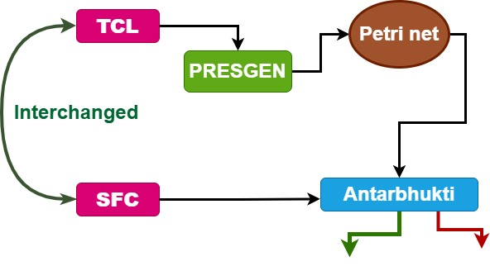
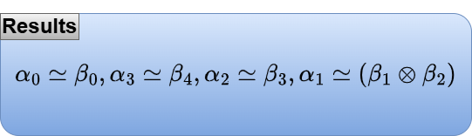
Equivalence checking
Notes:
Finally, the blue box highlights the outcome of the equivalence check.
Migration verifier builds on Antarbhukti by adding model-generation steps that TCL and SFC) into comparable Petri-net–based models.
The tool performs two-way containment checking—running Antarbhukti in both directions—
to determine whether both versions preserve each other’s behavior.
This extension transforms
Antarbhukti from a one-sided containment checker into a practical equivalence checker for software migration use case.

Slide 27
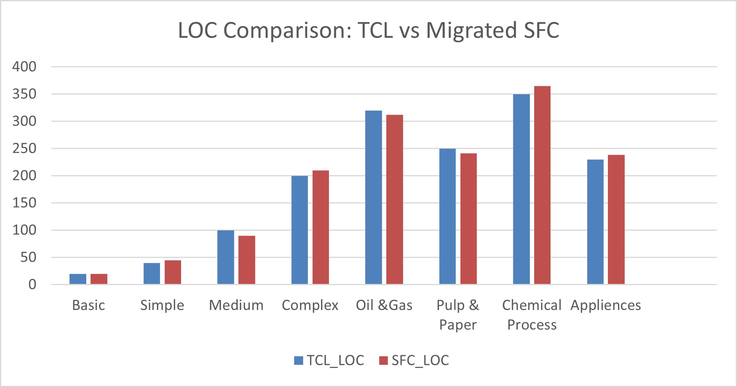
Results
Testing effort reduction
  60-70% cases (report from business team)
Migration assistance
Noteworthy Capabilities
  Data type migration
  Uniform and non uniform code motion during migration
  Code motion across loop
Notes:
We evaluated on 380 real industrial benchmarks.
It reduced manual testing effort by 60–70%, saving significant engineering time and cost.
The tool helped engineers validate upgrades, detect mismatches early, and manage complex code migrations — including data-type and loop-level changes.
Overall, it proved both practically impactful and industrially scalable for PLC evolution.

Slide 28

Thank You

