Slide 1
Verification of Concurrent Programs with Civl
https://civl-verifier.github.io
Shaz Qadeer
Meta

Slide 2
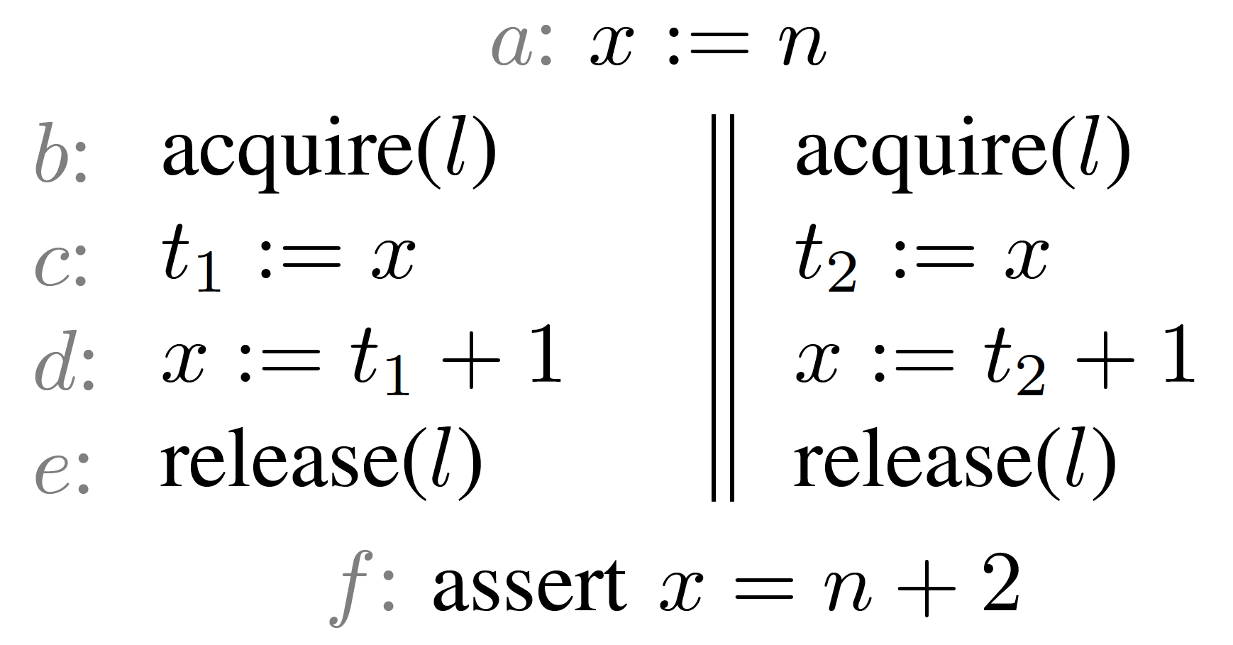
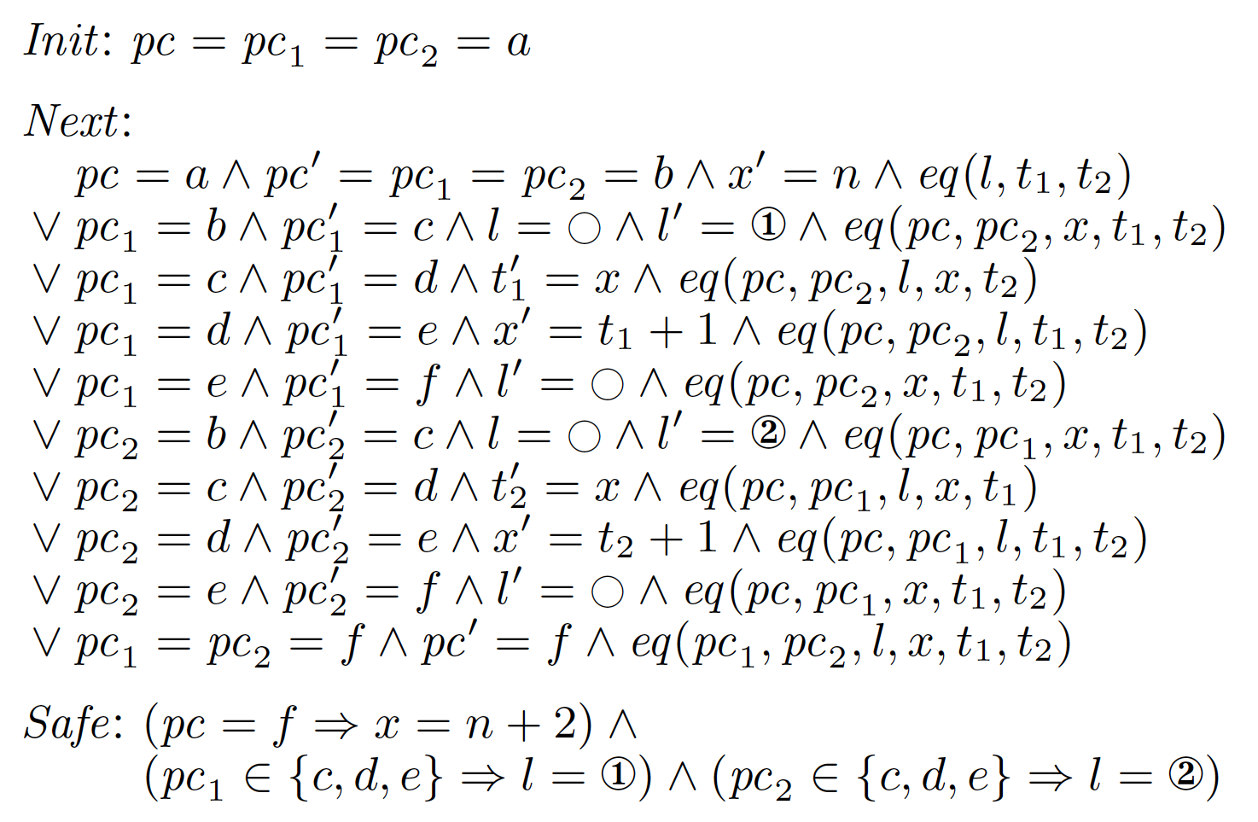
The transition system approach
lost program structure
Invent inductive invariant $Inv$
$Init⇒Inv$
$Inv∧Next⇒Inv^{′}$
$Inv⇒Safe$
complicated
invariants

Slide 3
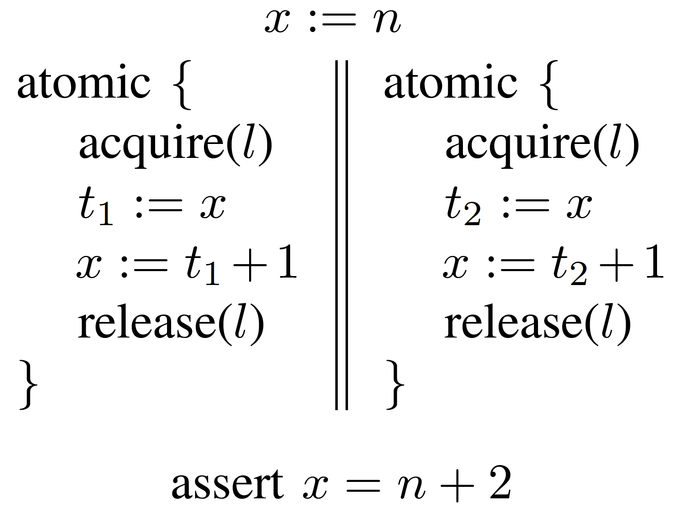
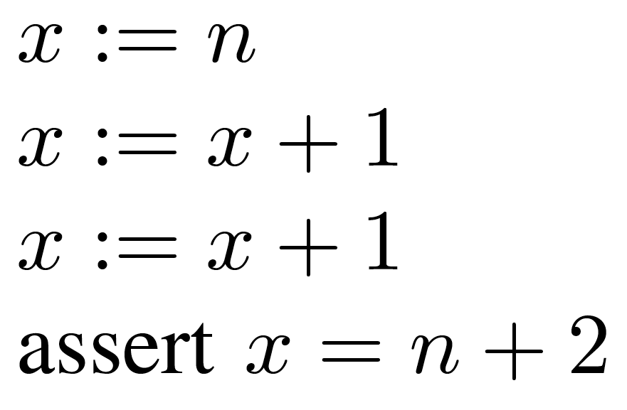
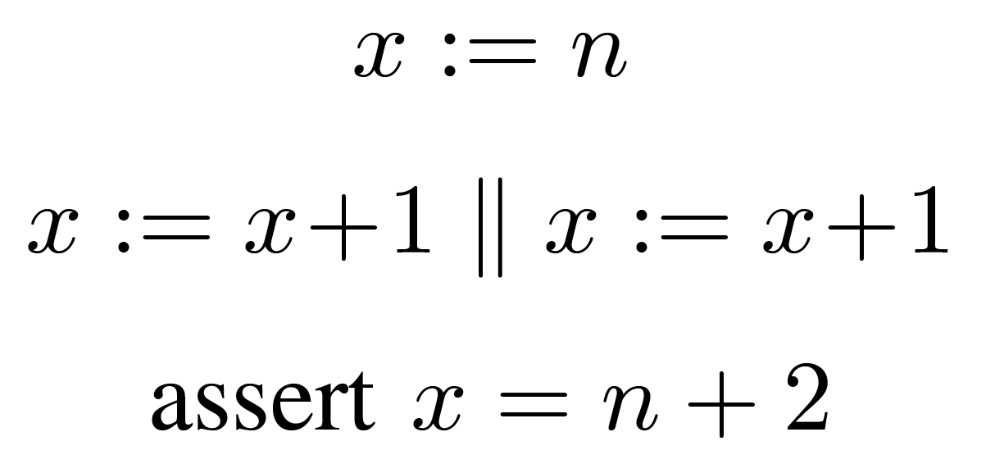

Slide 4
Realistic implementations
of large concurrent systems

Slide 5
Civl: layered refinement over structured concurrent programs
Layered Concurrent Program
$$𝒫_{n}$$
(abstract high-level specification)
$$≼$$
structured
program
$$𝒫_{n−1}$$
$$≼$$
$$≼$$
$$⋮$$
small program transformation
$$𝒫_{2}$$
$$≼$$
$$𝒫_{1}$$
(concrete low-level implementation)

Slide 6
Two large case studies
Concurrent garbage collector
Paxos
6
Actions to allocate, read/write fields, check equality
High-level specification
Consensus in a single atomic step
5
Atomic root scan
4
“Gray objects” stack ⇒ set
Atomic event handlers
abstract protocol state
3
Collector-mutator coordination for phase changes
2
Actions used in barrier synchronization
Low-level implementation
network, memory, …
1
Locks and read/write access
0
Atomic CPU operations
2130 LOC
853 LOC

Slide 7
Tactic 1: Creating atomic blocks
User declares mover types
Right mover
Left/Right mover
Left mover
Civl applies reduction
Pairwise commutativity checks
Mover sequence check
Lipton’s reduction:
Sequences of R*(N+$∈$)L* are atomic.
R
R
L
L
R
R
L
L

Slide 8
Tactic 2: Creating atomic actions
var b: bool
proc Acquire()
// yield
while true
// yield
exec s := CAS(b, false, true)
if (s)
break
// yield
action ACQUIRE()
assume b == false
b := true
Atomic lock spec
Concrete lock impl
Repeated compare-and-swap
Every execution of Acquire behaves like “SKIP*; ACQUIRE; SKIP*”.
SKIP
SKIP
ACQUIRE
CAS ✗
CAS ✗
CAS ✓

Slide 9
Tactic 3: Changing state representation
Concrete state
var b: bool
proc Acquire()
// yield
while true
// yield
exec s := CAS(b, false, true)
if (s)
break
// yield
var l: Option ThreadId
action ACQUIRE(tid)
assume l == None
l := Some(tid)
Abstract state
Every execution of Acquire behaves like “SKIP*; ACQUIRE; SKIP*”.

Slide 10
Tactic 3: Changing state representation
Concrete state
var b: bool
proc Acquire(tid)
// yield
while true
// yield
exec s := CAS(b, false, true)
if (s)
exec [l := Some(tid)]
break
// yield
var l: Option<ThreadId>
action ACQUIRE(tid)
assume l == None
l := Some(tid)
Abstract state
Introduced state
Introduced computation
Every execution of Acquire behaves like “SKIP*; ACQUIRE; SKIP*”.
b ⇔ l ≠ None
SKIP
SKIP
ACQUIRE
$$ℐ$$
$$ℐ$$
$$ℐ$$
$$ℐ$$
CAS ✗
CAS ✗
CAS ✓

Slide 11
Tactic 4: Synchronizing asynchrony
var x: nat
action ADD(i: nat)
x := x + i
action ASYNC_SUM(n: nat)
for i in 1..n
async ADD(i)
action SUM(n: nat)
x := x + (n * (n+1)) div 2
inv SUM_INV(n: nat)
var j: nat
assume 0 <= j && j <= n
x := x + (j * (j+1)) div 2
for i in j+1..n
async ADD(i)
Asynchronous executions
1: ADD(1) ADD(2) ADD(3) ADD(4) ADD(5) ADD(6) $⋯$
2: ADD(2) ADD(5) ADD(1) ADD(4) ADD(6) ADD(3) $⋯$
3: ADD(6) ADD(4) ADD(5) ADD(1) ADD(3) ADD(2) $⋯$
4: ADD(4) ADD(1) ADD(6) ADD(3) ADD(2) ADD(5) $⋯$
$$⋮$$

Slide 12
var b@[0,1]
var l@[1,2]
var x@[0,..]
right ACQUIRE@[2,2](linear tid)
assume l == None
l := Some(tid)
left RELEASE@[2,2](linear tid)
assert l == Some(tid)
l := None
both READ@[2,2](linear tid) : (v)
assert l == Some(tid)
v := x
both WRITE@[2,2](linear tid, v)
assert l == Some(tid)
x := v
proc Acquire@1(linear tid@[1,1]) refines ACQUIRE
var s@[0,1]
exec s := CAS(false, true)
if (s)
exec _SET_LOCK(Some(tid))
else
call Acquire(tid)
proc Release@1(linear tid@[1,1]) refines RELEASE
exec _SET()
exec _SET_LOCK(None)
proc Read@1(linear tid@[1,1]) : (v@[0,1]) refines READ
exec v := _READ()
proc Write@1(linear tid@[1,1], v@[0,1]) refines WRITE
exec _WRITE(v)
atomic CAS@[1,1](old, new) : (s)
s, b := old != new, new
atomic _SET@[1,1](v)
b := v
atomic _READ@[1,1]() : (v)
v := x
atomic _WRITE@[1,1](v)
x := v
intro _SET_LOCK@1(v)
l := v
atomic INC@[3,..]()
x := x + 1
proc Inc@2(linear tid@[1,1]) refines INC
var t@[0,2]
call Acquire(tid)
call t := Read(tid)
call Write(tid, t+1)
call Release(tid)
Notes:
global/local variables have layer ranges, atomic actions have layer ranges, procedures have hidden layer
global variables against atomic actions
procedures against called atomic actions and procedures
local variables for parameter passing in/out of procedures and atomic actions

Slide 13
Foundation: Gated atomic actions
(Gate, Transition)
single-state predicate
two-state predicate
Command | Gate | Transition
x := x+y | $$true$$ | $$x^{′}=x+y∧y^{′}=y$$
havoc x | $$true$$ | $$y^{′}=y$$
assert x<y | $$x<y$$ | $$x^{′}=x∧y^{′}=y$$
assume x<y | $$true$$ | $$x<y∧x^{′}=x∧y^{′}=y$$
Lock specification
var lock : ThreadID ∪ {nil}
Acquire(): [assume lock == nil; lock := tid]
Release(): [assert lock == tid; lock := nil]
Unifies precondition and postcondition
Primitive for modeling a (concrete or abstract) concurrent program

Slide 14
Foundation: Layered refinement
A refines B
iff
For every initial state s
if A goes wrong from s, then B goes wrong from s
if B does not go wrong from s and A can take s to s’,
then B can also take s to s’
$$\left(G, T\right) ≤\left(G^{′}, T^{′}\right) iff {(G}^{′}⇒G) ∧{(G}^{′}∧T⇒T′)$$

Slide 15
Foundation: Yield invariants
named
parameterized
invariant yield_x(i: int)
x ≥ i
assert x₀ ≥ x₀ // before call
// yield at entry
assume x₁ ≥ x₀
assume x₂ = x₁ + 1
assert x₂ ≥ x₂
// yield between increments
assume x₃ ≥ x₂
assume x₄ = x₃ + 1
assert x₄ ≥ x₀ + 2
// yield at exit
assume x₅ ≥ x₀ + 2 // after return
procedure double_inc()
requires yield_x(old(x))
[x := x + 1]
call yield_x(x)
[x := x + 1]
ensures yield_x(old(x) + 2)

Slide 16
Comparison to other approaches
global g
local l
…
C1
yield
C2
…
Location invariant
(Owicki-Gries)
Rely condition
(Jones)
Yield invariant
What state changes
are allowed here?
yield $φ$(l, g)
rely R(g, g’)
invariant P(l)
$φ$(l, g)
+ Precise
- Verbose
- Imprecise
+ Compact
+ Precise
+ Compact
# verification conditions
for non-interference
|Program|
✕
|Location invariants|
|Program|
✕
|Rely conditions|
|Program|
✕
|Yield invariants|

Slide 17
Foundation: Permissions
A permission is an ordinary program value
Permissions may be “embedded” in a program variable
conceptually, a function from the value of the variable to a set of permissions
Often essential for proving stability of yield invariants
Invariant enforced by linear typing and logical reasoning
permissions embedded in distinct variables (across all scopes) are disjoint
permissions are not duplicated (only redistributed) when variables are modified
Invariant assumed in verification conditions

Slide 18
Many open problems
Proof construction, debugging, and maintenance
satisfiability/reachability for verification conditions with quantifiers
propagation of invariants through calls and loops
Reliable encoding of composable finite types
datatypes, vectors, sets, maps
Reasoning about shared and mutable nested data structures
Layer inference

Slide 19
Example: Barrier synchronization

Slide 20
var barrierOn: bool
var barrierCounter: int
action EnterBarrier(i: Tid)
barrierCounter--
action ExitBarrier(i: Tid)
assume !barrierOn
barrierCounter++
procedure Mutator(i: Tid)
…
exec EnterBarrier(i)
exec ExitBarrier(i)
// access memory here
procedure Collector()
…
exec [barrierOn := true]
exec [assume barrierCounter = 0]
// do root scan
exec [barrierOn := false]

Slide 21
var barrierOn: bool
var barrierCounter: int
var barrierSet: Set Tid
action EnterBarrier(i: Tid)
barrierCounter--
barrierSet := barrierSet + {i}
action ExitBarrier(i: Tid)
assume !barrierOn
barrierCounter++
barrierSet := barrierSet - {i}
procedure Mutator(i: Tid)
…
exec EnterBarrier(i)
exec ExitBarrier(i)
// access memory here
procedure Collector()
…
exec [barrierOn := true]
exec [assume barrierCounter = 0]
// do root scan
exec [barrierOn := false]

Slide 22
var barrierOn: bool
var barrierCounter: int
var barrierSet: Set Tid
action EnterBarrier(i: Tid)
barrierCounter--
barrierSet := barrierSet + {i}
action ExitBarrier(i: Tid)
assume !barrierOn
barrierCounter++
barrierSet := barrierSet - {i}
procedure Mutator(i: Tid)
…
exec EnterBarrier(i)
call MutatorInv(i)
exec ExitBarrier(i)
// access memory here
invariant MutatorInv(j: Tid)
j ∈ barrierSet
procedure Collector()
…
exec [barrierOn := true]
exec [assume barrierCounter = 0]
call BarrierInv()
// do root scan
exec [barrierOn := false]
invariant BarrierInv()
barrierSet ⊆ [1..N]
|barrierSet| + barrierCounter = N
{MutatorInv(j)}
ExitBarrier(i)
{MutatorInv(j)}
{BarrierInv()}
EnterBarrier(i)
{BarrierInv()}
✗
✗

Slide 23
datatype Perm { Left(v: Tid), Right(v: Tid) }
var barrierCounter: int
var barrierSet: Lset Perm
action EnterBarrier
(in l: Lval Perm, r: Lval Perm, i: Tid)
assert l->val = Left(i) && r->val = Right(i)
barrierCounter--
l --> barrierSet
action ExitBarrier
(out l: Lval Perm, r: Lval Perm, i: Tid)
assert l->val = Left(i) && r->val = Right(i)
assert Left(i) ∈ barrierSet
barrierCounter++
barrierSet --> l
invariant MutatorInv(r: Lval Perm, j: Tid)
r->val = Right(j)
Left(j) ∈ barrierSet
{r->val}$∩$ {r’->val} = {}
$$⇒$$
{MutatorInv(r’, j)}
ExitBarrier(l, r, i)
{MutatorInv(r’, j)}

Slide 24
datatype Perm { Left(v: Tid), Right(v: Tid) }
var barrierCounter: int
var barrierSet: Lset Perm
action EnterBarrier
(in l: Lval Perm, r: Lval Perm, i: Tid)
assert l->val = Left(i) && r->val = Right(i)
barrierCounter--
l --> barrierSet
action ExitBarrier
(out l: Lval Perm, r: Lval Perm, i: Tid)
assert l->val = Left(i) && r->val = Right(i)
assert Left(i) ∈ barrierSet
barrierCounter++
barrierSet --> l
invariant BarrierInv()
barrierSet ⊆ [1..N]
|barrierSet| + barrierCounter == N
barrierSet $∩$ {l->val, r->val} = {}
$$⇒$$
{BarrierInv()}
EnterBarrier(l, r, i)
{BarrierInv()}

