Slide 1
Context-Bounded Verification of
Liveness Properties for
Multithreaded Shared-Memory Programs
Pascal Baumann, Rupak Majumdar,
Ramanathan Thinniyam, and Georg Zetzsche
Max Planck Institute for Software Systems

Slide 2
Context-Bounded Verification of
Liveness Properties for
Multithreaded Shared-Memory Programs
Pascal Baumann, Rupak Majumdar,
Ramanathan Thinniyam, and Georg Zetzsche
Max Planck Institute for Software Systems

Slide 3
Multithreaded Shared-Memory
Thread
Thread
Thread
Thread
Shared
Memory
x
y
OS, WebServers, Databases, Embedded Systems

Slide 4
Multithreaded Shared-Memory
Thread
Thread
Thread
Thread
New
spawned
Thread
New
spawned
Thread
x
Shared
Memory
y
OS, WebServers, Databases, Embedded Systems
Curse of Interleaving
Non-deterministic scheduling
Exponentially many behaviors: hard to detect, reproduce errors

Slide 5
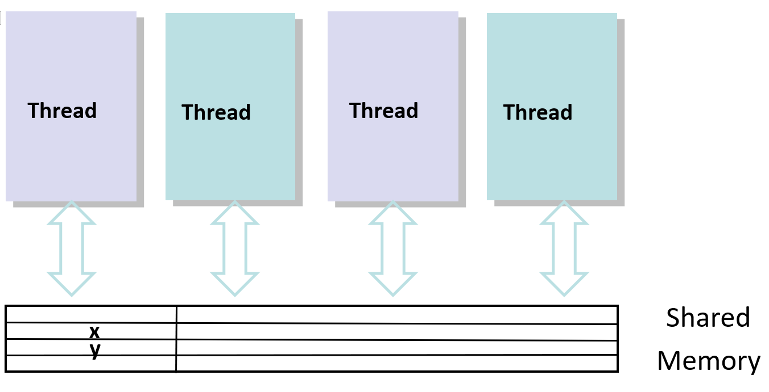
Multithreaded Shared-Memory
What is decidable?
Well known classical undecidability results
Reachability is undecidable (two recursive threads)
2 stacks can simulate a tape

Slide 6
Context-Bounded Verification of
Liveness Properties for
Multithreaded Shared-Memory Programs

Slide 7
k-Context Bounded Analysis
QadeerRehof05
AtigBouajjaniQadeer09
k-context bounded if any thread swapped in ≤k times
Theorem [AtigBouajjaniQadeer09]:
k-context bounded reachability (safety verification) is in 2EXPSPACE
What about liveness verification?

Slide 8
k-Context Bounded Analysis
QadeerRehof05
AtigBouajjaniQadeer08
k-context bounded if any thread swapped in ≤k times
Theorem [Our Contribution]:
Checking k-context bounded nontermination is 2EXPSPACE-complete
Checking k-context bounded fair nontermination is decidable
As hard as Petri net reachability already for k=0 [MajumdarGanty12]
`

Slide 9
Example
shared bool x := 0
init: spwn(a),spwn(out);
a() {
a1 if(x=0){spwn(a);spwn(b)}
a2 if * { a(); }
a3 if(x=0){spwn(b);spwn(a)}
}
b() { … }
out() { x := 1 }
Shared global variable
Initial spawns a,out
Dynamic thread spawning
Recursive call
Notes:
Details of programming model

Slide 10
Example
Program Configuration
shared bool x := 0
init: spwn(a),spwn(out);
a() {
a1 if(x=0){spwn(a);spwn(b)}
a2 if * { a(); }
a3 if(x=0){spwn(b);spwn(a)}
}
b() { … }
out() { x := 1 }
State: x = 0
Currently executing thread
Pending Threads
0: a
0: out
Notes:
Configuration of program and initialization

Slide 11
Example
Program Configuration
shared bool x := 0
init: spwn(a),spwn(out);
a() {
a1 if(x=0){spwn(a);spwn(b)}
a2 if * { a(); }
a3 if(x=0){spwn(b);spwn(a)}
}
b() { … }
out() { x := 1 }
State: x = 0
Currently executing thread
0:
a1
Pending Threads
0: out
Notes:
First thread starts running after being switched in

Slide 12
Example
Program Configuration
shared bool x := 0
init: spwn(a),spwn(out);
a() {
a1 if(x=0){spwn(a);spwn(b)}
a2 if * { a(); }
a3 if(x=0){spwn(b);spwn(a)}
}
b() { … }
out() { x := 1 }
State: x = 0
Currently executing thread
0:
a2
Pending Threads
0: a
0: out
0: b
Notes:
Recursion, spawning and stack growth.

Slide 13
Example
Program Configuration
shared bool x := 0
init: spwn(a),spwn(out);
a() {
a1 if(x=0){spwn(a);spwn(b)}
a2 if * { a(); }
a3 if(x=0){spwn(b);spwn(a)}
}
b() { … }
out() { x := 1 }
State: x = 0
Currently executing thread
0:
a3
a1
Pending Threads
0: a
0: out
0: b
Notes:
Recursion, spawning and stack growth.

Slide 14
Example
Program Configuration
shared bool x := 0
init: spwn(a),spwn(out);
a() {
a1 if(x=0){spwn(a);spwn(b)}
a2 if * { a(); }
a3 if(x=0){spwn(b);spwn(a)}
}
b() { … }
out() { x := 1 }
State: x = 0
Currently executing thread
Pending Threads
0: a
0: out
0: b
1:
a3
a1
Notes:
Switch to a new a.

Slide 15
Example
Program Configuration
shared bool x := 0
init: spwn(a),spwn(out);
a() {
a1 if(x=0){spwn(a);spwn(b)}
a2 if * { a(); }
a3 if(x=0){spwn(b);spwn(a)}
}
b() { … }
out() { x := 1 }
State: x = 0
Currently executing thread
0:
a1
Pending Threads
0: out
0: b
1:
a3
a1
Notes:
Recursion, spawning and stack growth.

Slide 16
Example
Program Configuration
shared bool x := 0
init: spwn(a),spwn(out);
a() {
a1 if(x=0){spwn(a);spwn(b)}
a2 if * { a(); }
a3 if(x=0){spwn(b);spwn(a)}
}
b() { … }
out() { x := 1 }
State: x = 0
Currently executing thread
0:
a1
Pending Threads
0: a
0: out
0: b
0: b
1:
a3
a3
a1
0: b
1:
0: b
a3
a3
a3
a2
0: a
Arbitrarily many threads with arbitrarily large stacks
0: b
Notes:
General configuration

Slide 17
The Nontermination Problem
shared bool x := 0
init: spwn(a),spwn(out);
a() {
a1 if(x=0){spwn(a);spwn(b)}
a2 if * { a(); }
a3 if(x=0){spwn(b);spwn(a)}
}
b() { … }
out() { x := 1 }
Given a program
and a bound k
Is there a k-bounded
nonterminating run?
Example: Yes:
Execute a ; a ; b; a; …

Slide 18
The Fair Nontermination Problem
shared bool x := 0
init: spwn(a),spwn(out);
a() {
a1 if(x=0){spwn(a);spwn(b)}
a2 if * { a(); }
a3 if(x=0){spwn(b);spwn(a)}
}
b() { … }
out() { x := 1 }
Fair run : every pending thread is eventually scheduled.
Example: In any fair run,
out is eventually scheduled
Given a program and a bound k is there a k-bounded fair nonterminating run?
Example: There is no k-bounded
fair nonterminating run (for any k)

Slide 19

Outline
Theorem: k-bdd nontermination in 2EXPSPACE
- Thread languages
- Downclosures
- Reduction to VASS
Theorem: k-bdd fair nontermination decidable
- Obstacles
- Proof Outline

Slide 20
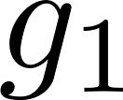
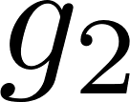
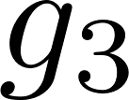
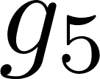
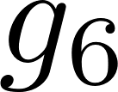


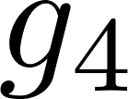
Generic Run of Program with k=2
Stack 1
Time
Stack 2
Time
Stack 3
Time
First thread switched out
First thread terminates

Slide 21
Language of a Thread
Stack 1
Time
Type of a thread = Sequence of global states g₀|g₁,g₂|g₃,g₅|g₆
Spawn word of thread =
Language = Spawn words from all executions
A context free language

Slide 22
Nontermination Preserved under Lost Spawns
Stack 1
Time
Type of a thread = Sequence of global states g₀|g₁,g₂|g₃,g₅|g₆
Spawn word of thread =
Language = Spawn words from all executions
A context free language
… with lost spawns
Haines’ Theorem
Downclosure of any
language is regular
A regular language
Subword order is a well-quasi-order

Slide 23

From Regular Threads to VASS
Global
State
State of executing thread
Finitely many states
0:
,
,
,
}
={
Spawned and waiting threads
. . .
Counter per (state,switch number)
0
1
k
Global
State
State of executing thread
Current state changes to green
0:
Spawned and waiting threads
While spawning new blue thread
. . .
0
1
k

Slide 24
From Regular Threads to VASS
Global
State
State of executing thread
0:
Spawned and waiting threads
Thread switched out
. . .
0
1
k
(purple,1) switched in
Global
State
State of executing thread
(green,1) counter incremented
1:
Spawned and waiting threads
Switch number increases from 0 to 1
. . .
0
1
k

Slide 25
From Regular Threads to VASS
Global
State
State of executing thread
0:
Spawned and waiting threads
Global state + counters = VASS
. . .
Exponential blow up on CFL to reg
0
1
k
+
EXPSPACE nontermination of VASS
Global
State
State of executing thread
1:
Theorem
Nontermination is in 2EXPSPACE
Spawned and waiting threads
. . .
0
1
k

Slide 26

Outline
Theorem: k-bdd nontermination in 2EXPSPACE
Theorem: k-bdd fair nontermination decidable
- From CFL to semilinear sets
- VASS with balloons
- Finite witnesses of fair nontermination
- Reachability in VASSB to VASS

Slide 27
Fair Nontermination: Obstacle to VASS
Fair termination is not preserved under lost spawns
shared bool x := 0
init: spwn(a),spwn(out);
a() {
a1 if(x=0){spwn(a);spwn(b)}
a2 if * { a(); }
a3 if (x=0){spwn(b);spwn(a)}
}
b() { … }
out() { x := 1 }
Cannot lose out
No regular equivalent!
Unbounded
Number of waiting threads
Stack size of each thread
Cannot be modeled by a VASS
Notes:
Cannot lose out ☺

Slide 28



Semilinear Representation of Language
Stack 1
Time
Ordering of spawns within a context does not matter
Type of a thread = Sequence of global states g₀|g₁,g₂|g₃,g₅|g₆
Spawn word of thread =
(
,
,
)
(
,
,
)
=
base
Spawn vector
+
2
(
,
,
)
period
Element of semilinear set

Slide 29
Semilinear Representation of Language
Parikh’s Theorem
Any CFL language is commutatively equivalent to a semilinear set.
Semilinearity enables us to shift tokens between balloons
Technique does not apply to certain more complex languages
-eg Higher Order Pushdown Languages

Slide 30
Outline
Theorem: k-bdd nontermination in 2EXPSPACE
Theorem: k-bdd fair nontermination decidable
- From CFL to semilinear sets
- VASS with balloons
- Finite witnesses of fair nontermination
- Reachability in VASSB to VASS

Slide 31



VASSB Definition
Balloon Operations
Unboundedly many Balloons
Creates a blue balloon with a vector from associated semilinear set
in
)
VASS counters
(
Global state
in
)
(
,
,
,
,
g
,
,
g
g
VASS counters
Balloon state red
(
,
)
Moves magenta tokens from blue balloon to VASS counter, changing color to red
def
VASS operations
(
-
)
def
,
,
,
,
g
g
,
,
g
+
-
(
)
Removes blue balloon along with contents
bst
,
,
g
(
)
bst
,
,
,
,
g
g

Slide 32

VASSB from Programs
Stack 1
Time
Differently coloured counters for different segments
=
Spawn vector
Stratified Balloon with three sections
Stratification implemented in formal model using additional colors
Type of a thread
Color of a balloon
Spawn vector
Balloon contents
Notes:
The VASSB obtained from DCPS are intended to store the spawn word which contains K+1 segments. We can encode which segment a token comes from using more colours. However, we will adopt the stratified balloon representation in the rest of this talk in order to more easily visualize the correspondence between the segments of the thread and the transfers from the balloon.

Slide 33
Reducing Fairness in Programs to Fairness in VASSB
Program
VASSB
Deflatable balloon eventually deflated
Schedulable thread
eventually scheduled
Global state
Global state
Newly spawned inactive
threads
Counters
Spawn vector of a thread
Balloon contents

Slide 34
Modelling programs with VASSB
shared bool x := 0
init: spwn(a),
spwn(out);
a() {
a1 if(x=0){spwn(a); }
a2 if * { a(); }
a3 if(x=0){spwn(b); }
}
b() { … }
out() { x := 1 }
spwn(b)
spwn(a)
Notes:
We simplify our initial example

Slide 35
Modelling programs with VASSB
shared bool x := 0
init: spwn(a),
spwn(out);
a() {
a1 if(x=0){spwn(a);}
a2 if * { a(); }
a3 if (x=0){spwn(b);}
}
b() { … }
out() { x := 1 }
An instance of an a thread
spawns a^{n}b^{n} for some number n.
However, not all spawns
may occur in same context.
Only counters and balloons
Notes:
1. Description of spawn language, preparing viewer for
2.
3. We assume that global state of VASSB tracks that of the program. So we only show the counters and the balloons

Slide 36
Modelling programs with VASSB
shared bool x := 0
init: spwn(a),
spwn(out);
a() {
a1 if(x=0){spwn(a);}
a2 if * { a(); }
a3 if (x=0){spwn(b);}
}
b() { … }
out() { x := 1 }
Current
Current
0:
a1
Inactive
Inactive
0: a
0: out
0: out
Switch in a thread = decrement counter
Notes:
Switching in a thread = decrement counter
Active thread info kept in global state.

Slide 37
Modelling programs with VASSB
shared bool x := 0
init: spwn(a),
spwn(out);
a() {
a1 if(x=0){spwn(a);}
a2 if * { a(); }
a3 if(x=0){spwn(b);}
}
b() { … }
out() { x := 1 }
Current
Guess the spawns of
each segment
0:
a1
Inactive
Two a’s in the first
Corresponding two b’s
in the second
0: out
Notes:
Switching in a thread = decrement counter

Slide 38

Modelling programs with VASSB
shared bool x := 0
init: spwn(a),
spwn(out);
a() {
a1 if(x=0){spwn(a);}
a2 if * { a(); }
a3 if(x=0){spwn(b);}
}
b() { … }
out() { x := 1 }
Current
Current
0:
a3
0:
a2
a1
Inactive
Inactive
0: out
0: a
0: out
0: a
Produce spawns = Deflate balloon
Notes:
Switching in a thread = decrement counter

Slide 39
Modelling programs with VASSB
shared bool x := 0
init: spwn(a),
spwn(out);
a() {
a1 if(x=0){spwn(a);}
a2 if * { a(); }
a3 if(x=0){spwn(b);}
}
b() { … }
out() { x := 1 }
Current
Current
0:
0:
a1
a3
a2
Inactive
Inactive
0: out
0: out
0: a
0: a
1:
a3
0: a
a2
Notes:
Notice increase in context switch number

Slide 40
Modelling programs with VASSB
Current
Current
shared bool x := 0
init: spwn(a),
spwn(out);
a() {
a1 if(x=0){spwn(a);}
a2 if * { a(); }
a3 if(x=0){spwn(b);}
}
b() { … }
out() { x := 1 }
0:
a1
Inactive
Inactive
0: out
0: out
0: a
0: a
1:
a3
a2
1:
a3
a2
0: a
0: b
Thread runs to completion
Spawns ab in first segment, none in second
Notes:
Notice increase in context switch number
Also note that the type is reflected in the state of the balloon, which is thicker

Slide 41
Modelling programs with VASSB
Current
Current
shared bool x := 0
init: spwn(a),
spwn(out);
a() {
a1 if(x=0){spwn(a);}
a2 if * { a(); }
a3 if(x=0){spwn(b);}
}
b() { … }
out() { x := 1 }
0:
a1
Inactive
Inactive
0: out
0: out
0: a
0: a
1:
a3
a2
1:
a3
a2
0: a
0: b
Thread runs to completion
Deflated balloon is empty
Notes:
Notice increase in context switch number
Also note that the type is reflected in the state of the balloon, which is thicker

Slide 42
Modelling programs with VASSB
Current
Current
shared bool x := 0
init: spwn(a),
spwn(out);
a() {
a1 if(x=0){spwn(a);}
a2 if * { a(); }
a3 if(x=0){spwn(b);}
}
b() { … }
out() { x := 1 }
0:
a1
Inactive
Inactive
0: out
0: out
0: a
0: a
1:
a3
a2
1:
a3
a2
0: a
0: b
Thread runs to completion
Burst empty balloon
Notes:
Notice increase in context switch number
Also note that the type is reflected in the state of the balloon, which is thicker

Slide 43
Modelling programs with VASSB
shared bool x := 0
init: spwn(a),
spwn(out);
a() {
a1 if(x=0){spwn(a);}
a2 if * { a(); }
a3 if(x=0){spwn(b);}
}
b() { … }
out() { x := 1 }
Current
Current
1:
a3
a2
Inactive
Inactive
0: out
0: out
0: a
0: a
0: a
0: a
0: b
0: b
0: b
0: b
Initial thread switched back spawns two b’s

Slide 44
Modelling programs with VASSB
shared bool x := 0
init: spwn(a),
spwn(out);
a() {
a1 if(x=0){spwn(a);}
a2 if * { a(); }
a3 if(x=0){spwn(b);}
}
b() { … }
out() { x := 1 }
Current
Current
0: out
Inactive
Inactive
0: a
0: a
0: b
0: b
0: b
Program terminates
VASSB terminates

Slide 45
Outline
Theorem: k-bdd nontermination in 2EXPSPACE
Theorem: k-bdd fair nontermination decidable
- From CFL to semilinear sets
- VASS with balloons
- Finite witnesses of fair nontermination
- Reachability in VASSB to VASS

Slide 46

Self Covering Witness 1
Want: Finite witness for infinite fair run
,
,
g₁
g₄
,
g₄
,
VASS
g₃
Self covering
,
,
,
g₁
g₄
,
g₄
g₄
Infinite Unrolling
,
,
g2
VASSB
g2
,
,
What to do with balloons?

Slide 47


Self Covering Witness 2
Guarantee run with infinitely many configurations with
only empty balloons
Finite Stem
Loop
Unrolling
C₀=
,
,
g₀
C₁=
,
,
g₄
,
C₃=
g₄
,
C₂=
,
g₄
,
C₁
Is a finite witness
C₀
C₂

Slide 48
Infinitely often Appearing Colors in Infinite Runs
Finite Prefix
Infinite Suffix
,
g1
,
,
,
g3
,
g2
,
,
,
g2
Infinitely Appearing Token Colors
:
and
Infinitely Appearing Balloon Colors
and
:

Slide 49
Key Concept: Token Shifting in Infinite Runs
Infinite Suffix
(
)
(
)
(
)
(
)
in
in
in
bst
(
)
(
)
in
in
(
)
(
)
(
)
bst
in
in
(
)
(
)
bst
bst
Segment i
Segment i+1
Infinitely often occurring balloon colors
,
}
=
{
Pick one balloon per color
Corresponding burst operations

Slide 50
Key Concept: Token Shifting in Infinite Runs
Infinite Suffix
(
)
(
)
(
)
(
)
in
in
in
bst
(
)
(
)
in
in
(
)
(
)
(
)
bst
in
in
(
)
(
)
bst
bst
Segment i
Segment i+1
Infinitely often occurring balloon colors
,
}
=
{
Pick one balloon per color
Corresponding burst operations
Shift tokens of unpicked balloons to previous segment
Token shifting from segment i+1 to segment i
Token shifting is possible because of semilinearity

Slide 51
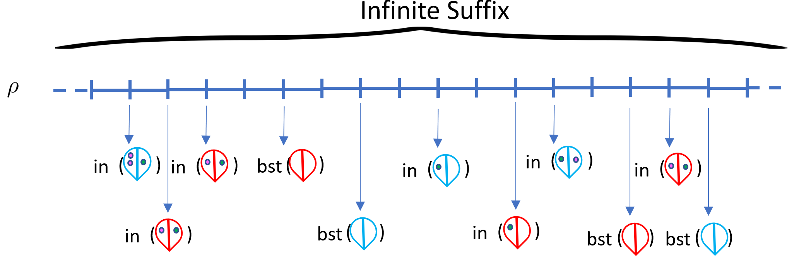
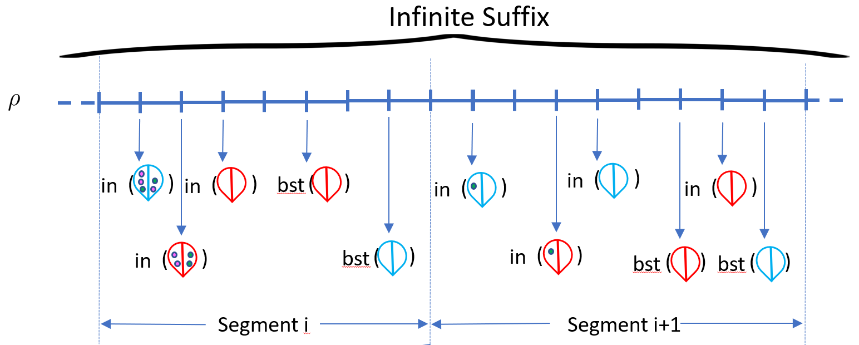
Validity of New Run
Tokens transferred in
segment i+1 …
Are already transferred in
segment i
Original Run
For each j, configurations satisfy
c_{j} (old) ≤ c_{j} (new)
Monotonicity of VASS
Any operation enabled at c_{j} (old)
also enabled at c_{j} (new)
New Run

Slide 52
After Token Shifting
Infinite Suffix
(
)
(
)
(
)
(
)
in
in
in
bst
(
)
(
)
in
in
(
)
(
)
(
)
bst
in
in
(
)
(
)
bst
bst
Segment i
Segment i+1
Infinitely often occurring balloon colors
,
}
=
{
At configuration c_{i} :
Picked balloons have been burst and other balloons are empty
c_{i} only contains empty balloons

Slide 53

After Token Shifting
Infinite Suffix
,
,
g1
,
,
g4
,
g4
,
,
,
g3
,
g2
,
,
g4
,
Infinitely many configurations with only empty balloons
c₁=
c₂=
c₃
,
,
g4
,
g4
,
Can pick c_{i} and c_{j} far away enough to satisfy fairness
Search for witness easily reduces to reachability in VASSB

Slide 54
Outline
Theorem: k-bdd nontermination in 2EXPSPACE
Theorem: k-bdd fair nontermination decidable
- From CFL to semilinear sets
- VASS with balloons
- Finite witnesses of fair nontermination
- Reachability in VASSB to VASS

Slide 55
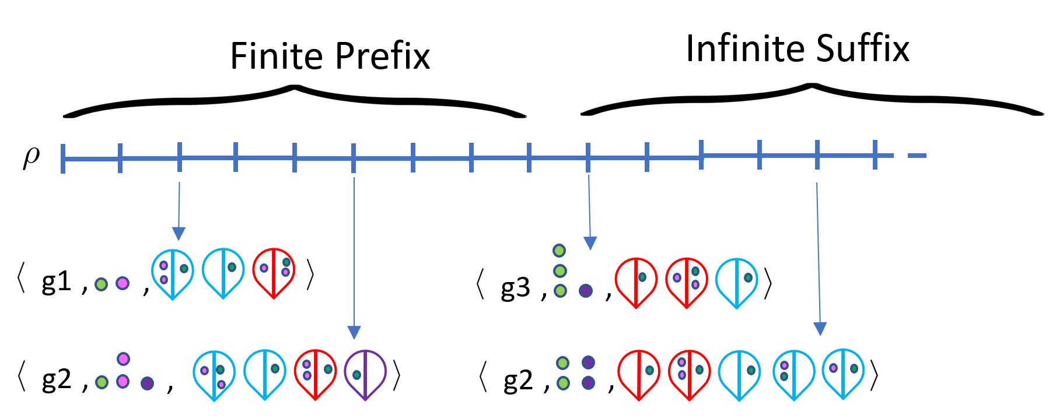
Reachability in VASSB to VASS
Want: VASSB run containing bounded number of nonempty balloons
Arbitrarily large
Token shifting fails for finite run
Modify token shifting to work for finite runs
VASSB from Programs have special structure, results for general VASSB in paper

Slide 56
Two Similar Balloons in a Finite Run
B₁
B₂
B₁
B₂
bst
)
def
)
(
(
)
(
inf
(
)
B₁
def
B₂
B₁
bst
)
B₁
def
)
(
def
)
(
(
)
(
B₁
inf
B₂
B₂
B₂
Balloons B₁ and B₂ inflated with same color
B₁ undergoes deflate first, changing color to red
B₂ undergoes same deflate as B₁
Future deflates have same pattern: first B₁ then B₂
Both balloons get burst
B₁ and B₂ are similar

Slide 57
New Token Shifting: Similar Balloons
(
)
inf
B₁
(
)
inf
B₂
Tokens of B₂ of shifted to B₁

Slide 58
New Token Shifting: Similar Balloons
B₁
B₂
B₁
B₂
bst
)
def
)
(
(
)
(
inf
(
)
B₁
def
B₂
B₁
bst
)
B₁
def
)
(
def
)
(
(
)
(
B₁
inf
B₂
B₂
B₂
Tokens of B₂ of shifted to B₁
B₂ is empty in new run
New run is valid by monotonicity
Combinatorial argument needed to guarantee similar balloons
Similar balloons guaranteed if total balloons above threshold

Slide 59
After New Token Shifting in the Finite
The mentioned threshold only depends on the VASSB.
Token shifting gives run with bounded number of nonempty balloons
Such bounded runs easily simulated using VASS.

Slide 60
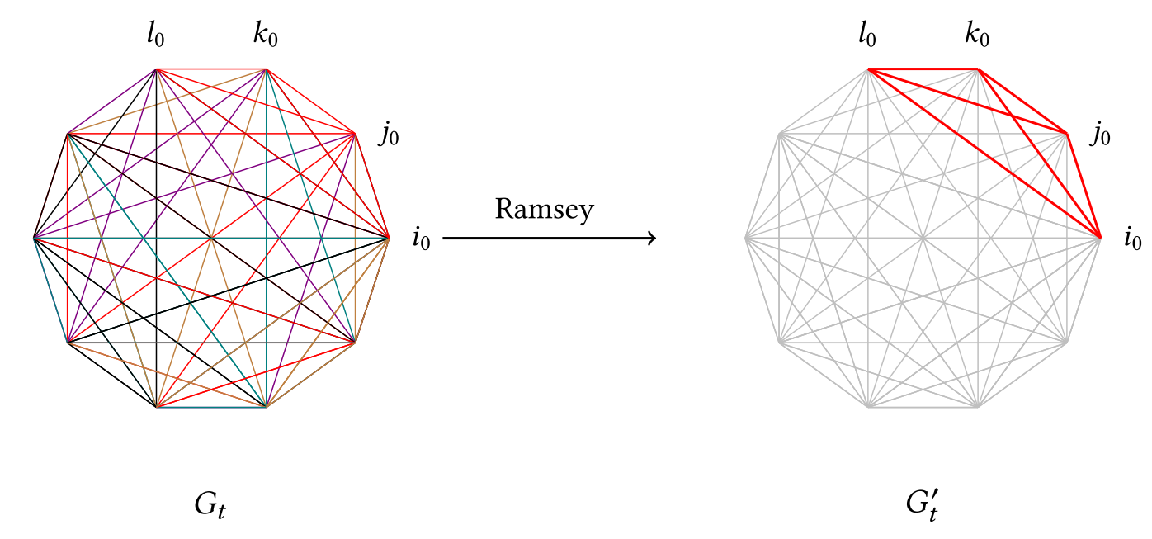
More in the Paper…
k-bdd fair nonstarvation is decidable
  A fair run is nonstarving if every pending thread runs to termination
Combinatorial arguments

Slide 61
Conclusion
The K-bdd nontermination problem is 2EXPSPACE-complete.
The K-bdd fair nontermination problem is decidable.
The K-bdd fair starvation problem is decidable.
New model: VASSB decidable extension of VASS.

Slide 62
Questions?
http://www.mpi-sws.org/~thinniyam/

